Slide 1
Unbreakable Delivery Pipeline
July, 2018

Slide 2
Unbreakable Delivery Pipeline – Reference Episode
Goal:
Moving from manual build validation to a fully automated continuous delivery pipeline with automated quality gates all the way into production. Increase Successful Production Deployments
Assumptions: Existing CI/CD pipeline that deploys into different environments monitored with Dynatrace
Sprint 1
Integration Phase: Commit-triggered Continuous Build Validation
"Shift-Right": Every deployment automatically tracked by Dynatrace
Implementing "Shift-Left": Automated Build Validation
Visualize Dynatrace Validation in the Build Pipeline Reports, UFO, DAVIS and Chat Channel
Include Dynatrace Integration Build Validation Results in Daily Standups
Sprint 2
Continuous Performance Validation
Automate Deployment from Integration into Continuous Performance Environment (scheduled: daily, bi-daily, …)
Automate Continuous Performance Build Validation
Visualize Build Validation in Pipeline and Dynatrace UFO
Include Dynatrace Continuous Performance Build Validation Results in Daily Standups
Sprint 3
Implement automated rollback in Continuous Performance Environment
Define, refine and automate processes for rollout and rollback of bad builds in Continuous Performance
Integrate with Incident Management Tools
Execute “Fire Drill” to simulate “a Bad Build into Production-like environment”. Validate response actions and Time to Remediation!
Visualize Status of “Production-like” environment with UFO
Sprint 4
Continuous Deployment into Production
Trigger Production Deployment based on Good Continuous Performance Build Validation
Push ownership of pipeline quality towards engineering
Validate more successful & stable production deployments
Visualize Status of Production with UFO
Onboard NEXT Pipeline
Kick Off with Management
Review with Management
Notes:
Notes with more details on each Sprint
Sprint 1
- Unbreakable Pipeline Workshop based on Testbed
- Validate Pre-Requisits (Jenkins, Bamboo, Concourse, Travis, …)
- Define and Test Meta Data to be pushed (Shift-Right) to Dynatrace per pipeline run and how to pass it over (Lambda, CLI, …)
- Define and Test Monspec for "Shift-Left"
- Outcome: Validated Monspec works for both push deployments and pull key metrics
- Outcome 2: We know technically how to integrate CI/CD with Dynatrace
Sprint 2
- Enable/Build Integration between CI/CD and Dynatrace for "Shift-Right"
- Enable/Build Integration between CI/CD and Dynatrace for "Shift-Left" (Break the Pipeline)
- Refine Integration and Monspec through continuous testing of the pipeline.
- Define whether Dynatrace acts as automated or semi-automated quality gate (Based on customer policies)
- Outcome: fully integrated Shift-Left & Shift-Right Use Cases for a single delivery pipeline
- Outcome: Research on Rollbacks or Blue/Green Strategy for Sprint 3
Sprint 3
- Implement Rollback option and make it available through a WebHook
- Deploy "Blue/Green" in last stage of pipeline
- Define Incident Notification for "Blue/Green" stage to trigger rollback WebHook
- Validate Pipeline by simulating "a bad production build"
- Outcome: Implemented last phase of "Unbreakable" pipeline: Self-Healing
- Outcome 2: Pick the next pipeline project for Sprint 4
Sprint 4
- Setup UFO with Pipeline
- Implement for a second pipeline
- Outcome: Validated that Dynatrace Unbreakable Pipeline works across multiple pipeline projects

Slide 3
Outline (for 3 hrs)
Introduction – What is the workshop about? (~10 min)
Labs (1h30min)
Run the CloudFormation Stack to create the AWS CodePipeline (~10min)
Configure Automated Tagging Rule (~5min)
Re-Run Pipeline and observe results (~10min)
Simulate a Bad Build (Build #2) (~10min)
Simulate a Good Build (Build #3) (~20min)
Setup “Automated Rollback” for Production (~5min)
Simulate a Bad Production Deployment (Build #4) (~20min)
Recap (~15 min)

Slide 4
THE BIG PICTURE What we are going to do today!

Slide 5


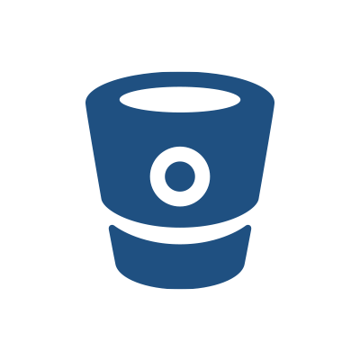






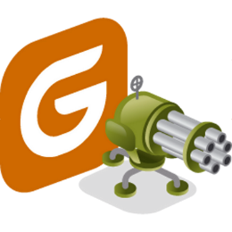


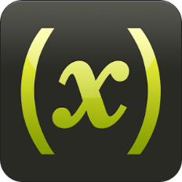




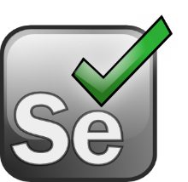









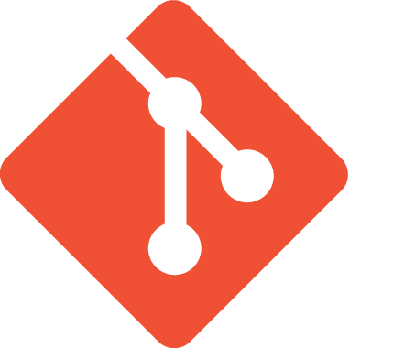
Shift-Left: Break Pipeline Earlier
Shift-Right: Tags, Deploys, Events
Dev
Perf/Test
Ops
Biz
Actionable Feedback Loops
Path to NoOps: Self-Healing, …
Notes:
But there is more than production! There is more we can do throughout the whole DevOps Toolchain

Slide 6
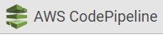
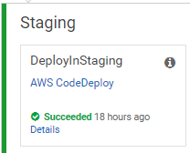
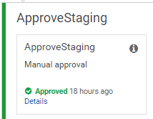
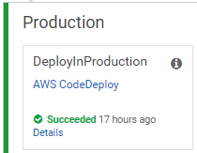
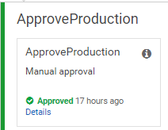




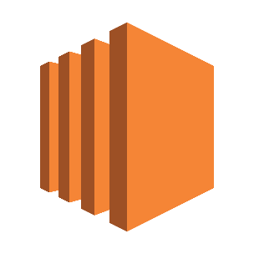


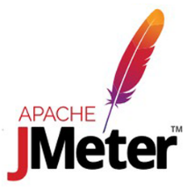

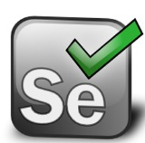
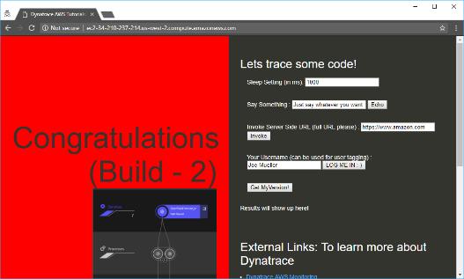
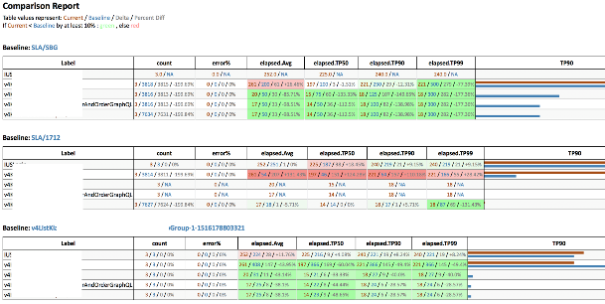
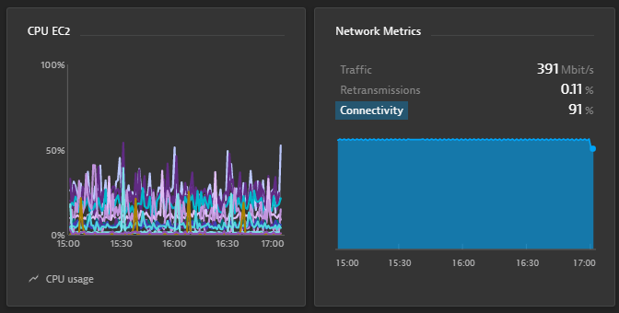
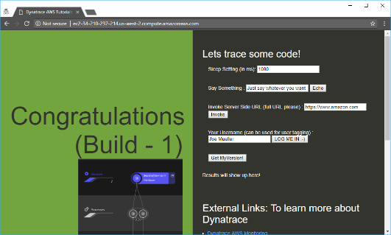
https://github.com/Dynatrace/AWSDevOpsTutorial
AppTeam
Users
AWS CodeDeploy
AWS CodeDeploy
Manual Approval
Manual Approval
Manual Rollback
AWS EC2 (Tag=Staging)
AWS EC2 (Tag=Production)

Slide 7
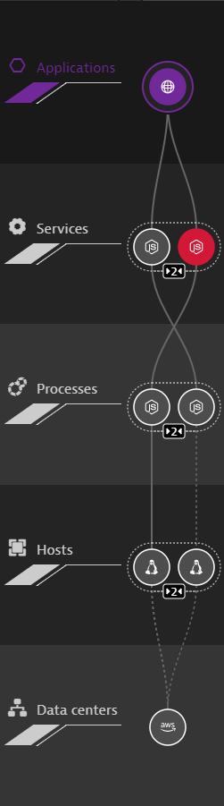
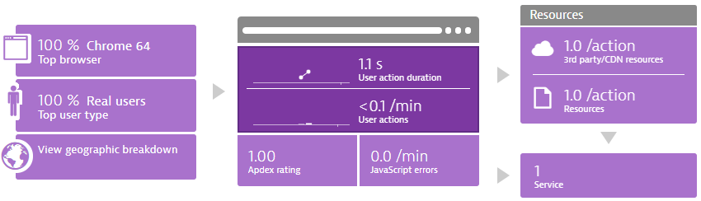
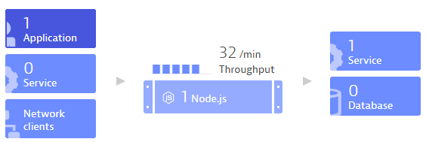
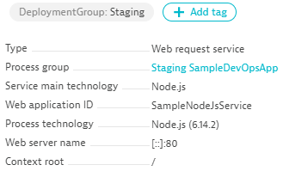


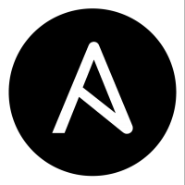

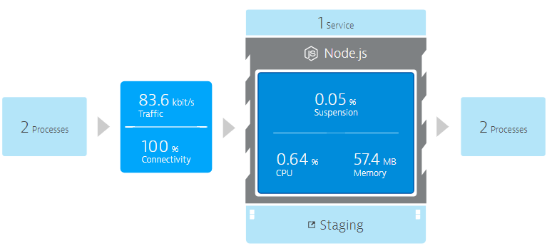
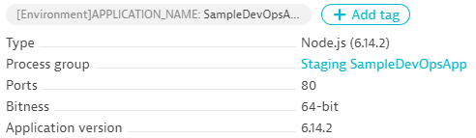
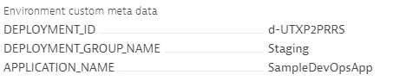

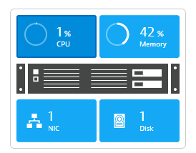


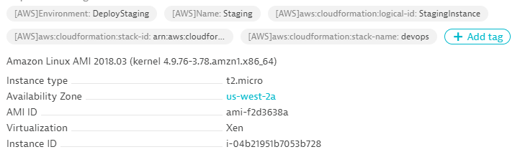


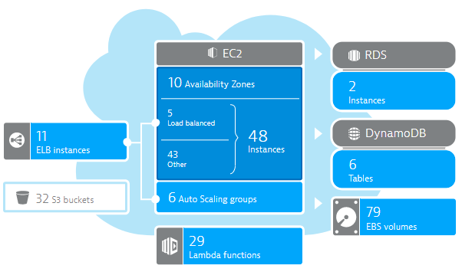
DT_TAGS=APP_NAME=Sample
DT_CUSTOM_PROPS=Staging
DT_CLUSTER_ID=MyNodeJs
launchApp.sh
User Data:
wget OneAgent.sh
./OneAgent.sh
AWS EC2 (Tag=Staging)
CloudWatch

Slide 8
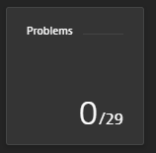
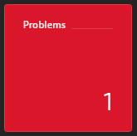
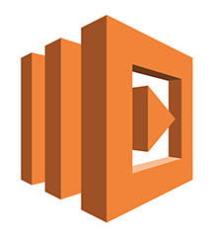
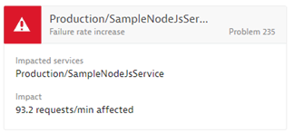
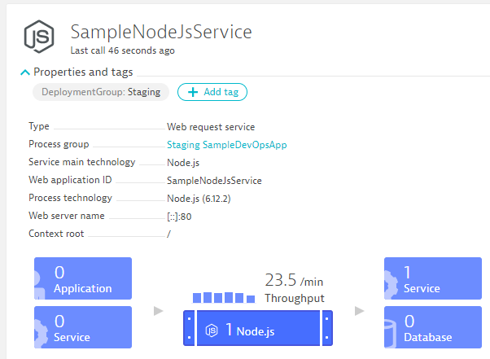
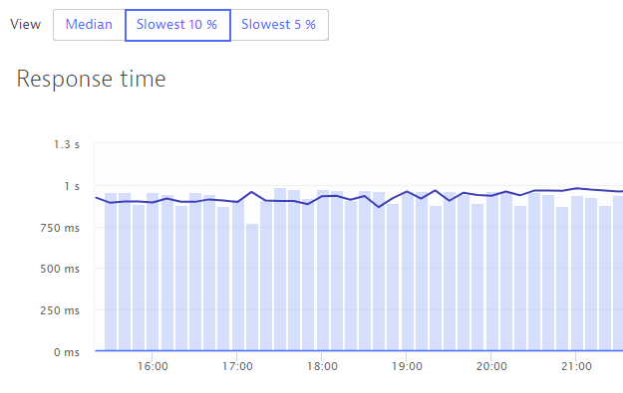
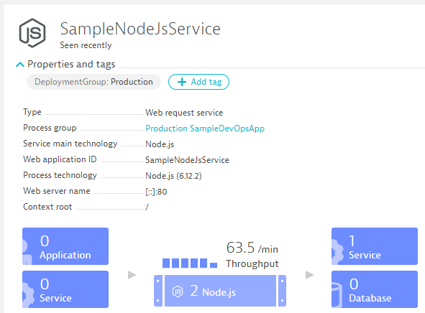
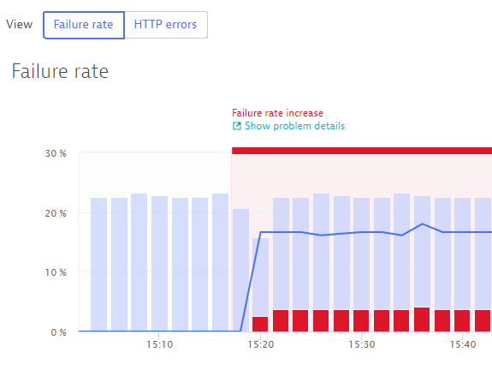

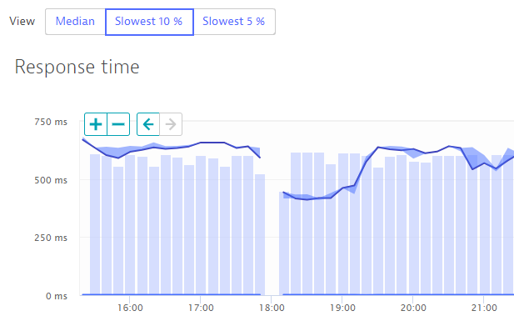
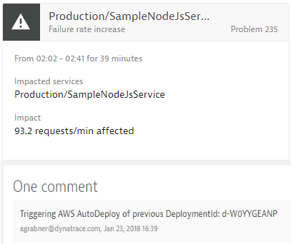
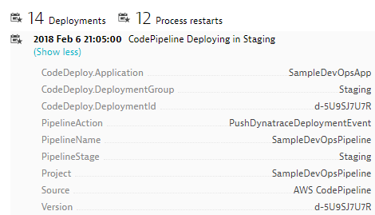
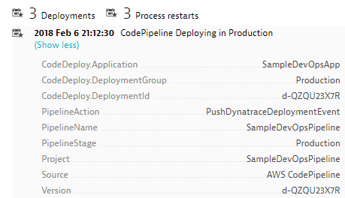
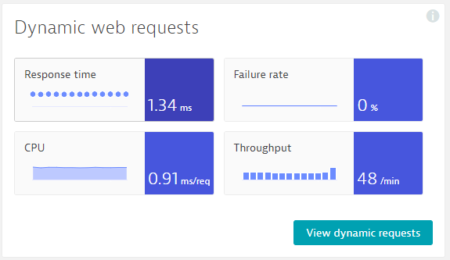
https://github.com/Dynatrace/AWSDevOpsTutorial
Self-Healed
Auto-Approve!
Auto-Approve!
Auto-Reject!
Auto-Reject!
pushDynatraceDeploymentEvent
Pushes Deployment Info to Dynatrace Entities
validateBuildDynatraceWorker
Compares Builds and Approves/Rejects Pipeline
pushDynatraceDeploymentEvent
Pushes Deployment Info to Dynatrace Entities
validateBuildDynatraceWorker
Validates Production and Approves/Rejects Pipeline
Build 6
Production
handleDynatraceProblemNotification
Executes Auto-Remediating Actions, e.g: Rollback
Build 7
Production

Slide 9






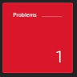
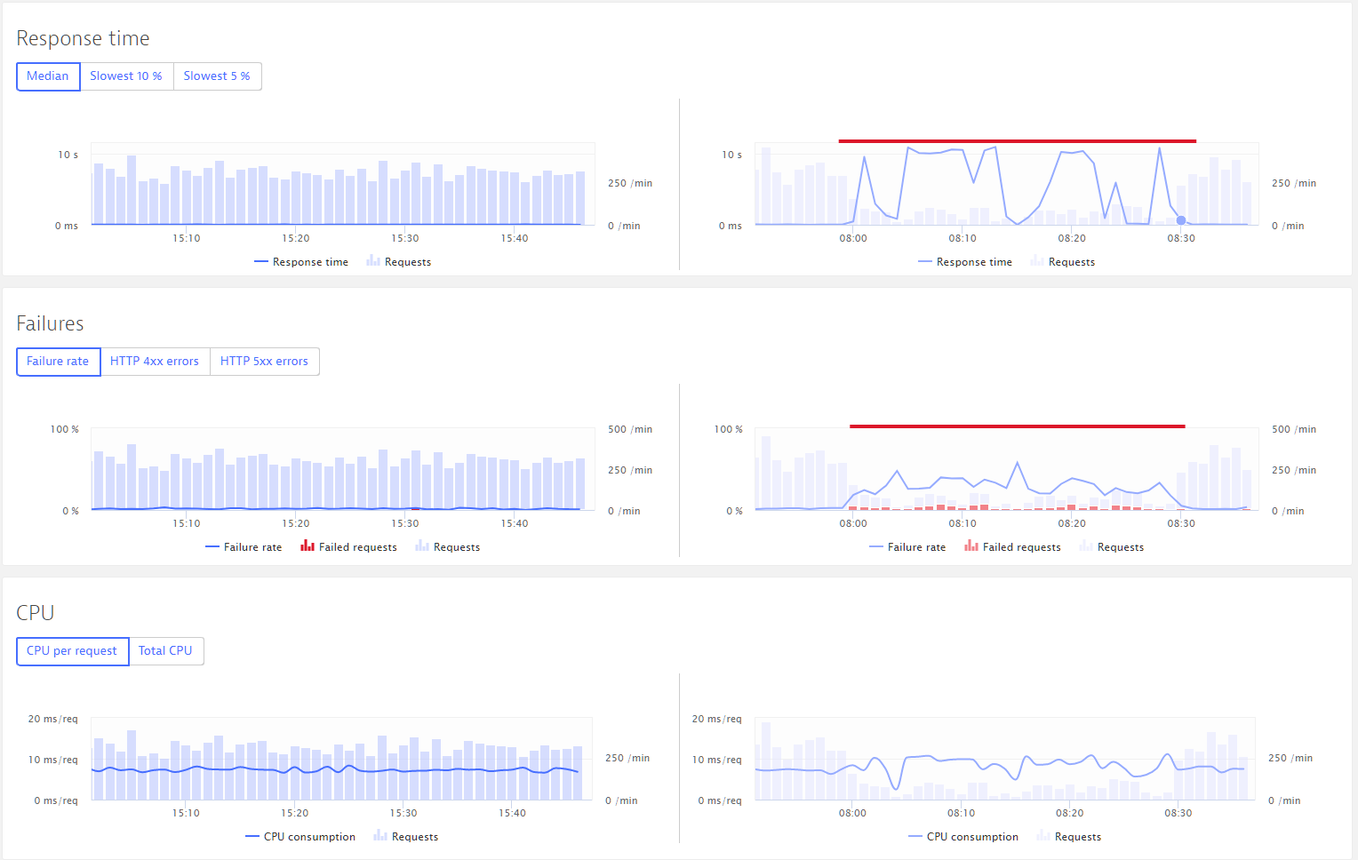
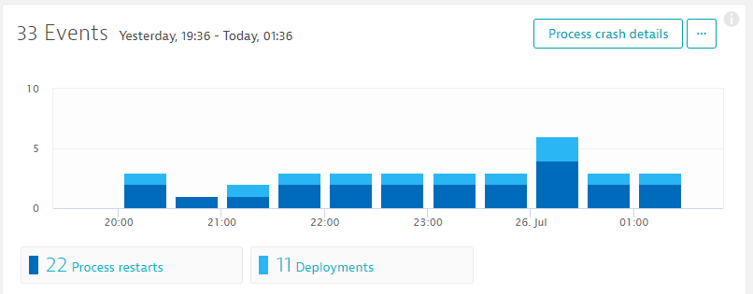
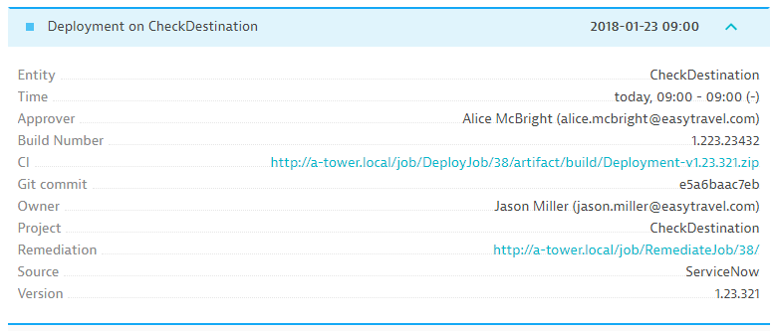
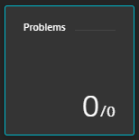

1
2
Production
4
5
Staging
Approve Staging
3
Approve Production
CI CD
CI CD
CI CD
CI CD
Pushes deployment into Dynatrace entities
Compares builds and approves / rejects pipeline
Pushes deployment info into Dynatrace entities
Validates production and approves / rejects pipeline
Build #17
Build #18
Production
Executes auto-remediating actions e.g. roll-back
Simplify DevOps complexity – automated full stack performance monitoring – see it to believe it – Dynatrace.com/trial/

Slide 10
THE WORKSHOP

Slide 11
Based on https://github.com/Dynatrace/AWSDevOpsTutorial
For AWS please follow https://github.com/Dynatrace/AWSDevOpsTutorial
For Jenkins please follow https://github.com/dynatrace-innovationlab/jenkins-dynatrace-pipeline-tutorial
For VSTS please see https://github.com/dynatrace-innovationlab/unbreakable-pipeline-vsts
More information about Unbreakable Pipeline read https://www.dynatrace.com/news/blog/unbreakable-devops-pipeline-shift-left-shift-right-self-healing/

